Slide 1

Using Computer Learning to Identify Depression in Reddit Social Media
Leonardo Luchetti, Jiahui Ren, Ignacia Araya, Dante Dupont, Tyler DiNapoli-Chiappelli
Text Mining - Spring 2021 - Professor Yilu Zhou

Slide 2

Problem Description
7.1% of adults of all U.S. have suffered a major depressive episode [1]
35% of adults with major depressive episodes did not receive treatment
The earlier the treatment begins, the more effective it is
How to Identify Depression in Text to Aid Early Detection
Abundance of user generated content, which can be used for a good purpose

Slide 3

Dataset
Source | Crawled data from Reddit through API
Data Size | 7095 rows (different subreddit entries) x 9 columns = 63,855
Format | CSV
Period | 2009-2021
Data Type | Numeric (e.g. Score ), Text(e.g. Body), Categorical (e.g. Subreddit)
Data Scale | Nominal(e.g. Title)

Slide 4
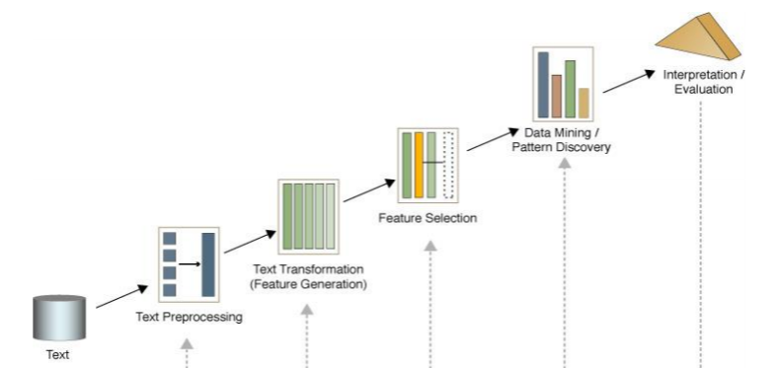
Project Framework
Develop project idea.
Scrape data from specific subreddits using the Reddit API.
Read some text mining/computational linguistic research papers to figure out what features (X-variables) previous studies have used when applying Machine Learning to the task of identifying depression on social media.
In Python, create Machine Learning and Deep Learning models.
Test how good the models are at detecting things RELATED to depression, such as addiction and suicidal thoughts.
Present final results and conclusion
Notes:
Note: TDC made some alterations on 5/4/2021 to the original slide Sofia made to clarify a few of the project steps.

Slide 5

Data Preprocessing
Imported Reddit data into Python and formed the dependent variable by labelling subreddits as “1” if it was likely indicative of depression, or “0” if not.
Deep Learning:
Stopwords were removed, any non-alphabetical characters were removed, and the Porter Stemmer was applied.
Text was one-hot encoded at the word level.
For Machine Learning:
Non-alphabetical characters were removed and each post was tokenized.
Three different feature sets were then created, per the guidelines of each of the three research papers the group consulted.
Note: the research papers did not remove stopwords or apply stemmers; thus, neither did we.

Slide 6
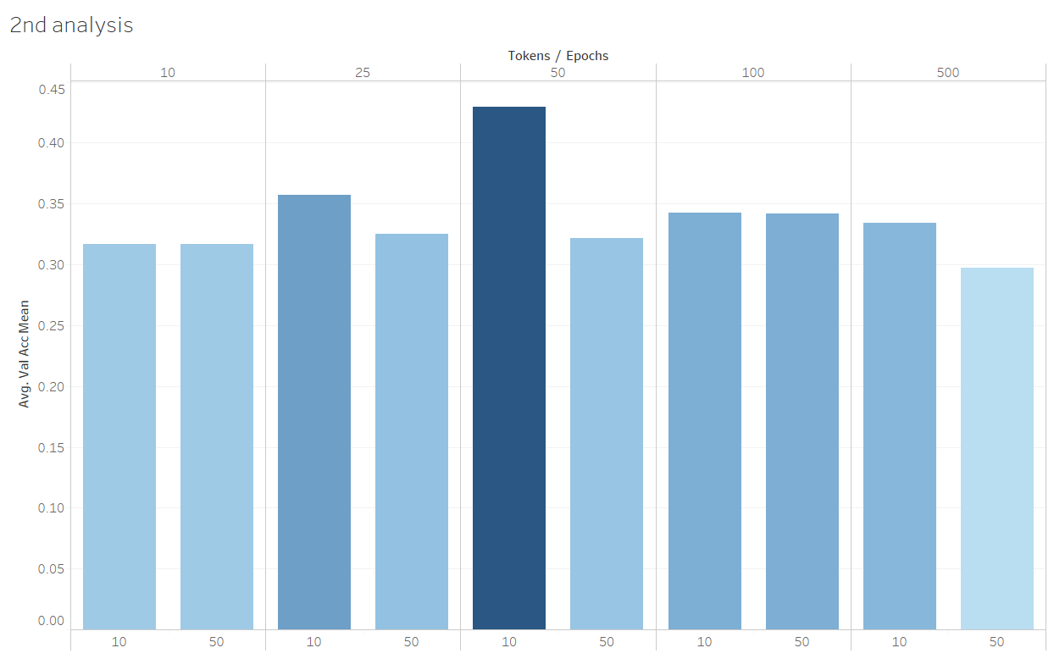
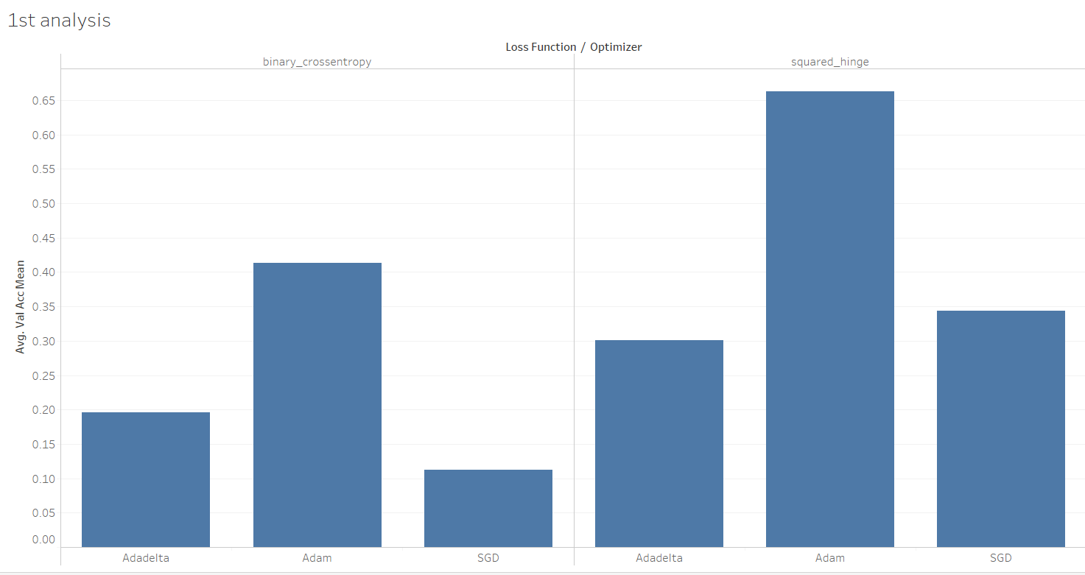
Model Design - Deep Learning
LSTM and Dense, LSTM with a dropout layer and Dense, RNN, Dense with sigmoid activation, Dense with ReLU activation, and Dense with ReLU and sigmoid activations

Slide 7
Model Design - Machine Learning
Sets of Features
Models
Depression Detection from Social Media Texts
Utilizing Neural Networks and Linguistic Metadata for Early Detection of Depression Indications in Text Sequences
In an Absolute State: Elevated Use of Absolutist Words Is a Marker Specific to Anxiety, Depression, and Suicidal Ideation
Logistic Regression
K-NN
Classification tree
Random Forest Classifier
Adaboost

Slide 8
Results
 | Deep Learning | Psycholinguistic Markers | Metadata | Absolutist Word
Best Model | 2 Dense Layers with Sigmoid Activation | AdaBoost(with Decision Tree Classifier) | AdaBoost(with Decision Tree Classifier) | AdaBoost(with Decision Tree Classifier)
Accuracy Score | 1.00 | 1.00 | 1.00 | 0.77
F score | 1.00 | 1.00 | 1.00 | 0.84
False Negative Rate | 0.00 | 0.00 | 0.00 | 0.07
Accuracy Score when Tested with New Data | 0.91 | 0.77 | 0.67 | 0.84

Slide 9


Conclusions and Future Directions -
Psycholinguistic markers prove to be effective for noticing depression patterns on our selected subreddits
Our results show the power and adaptability of a well tuned deep learning model
More research across the rest of Reddit and other social media sites would be the ideal place for us to focus future research.
Note: our models do not diagnose depression and can not do so
They could be useful as the basis for future research looking to better track people’s mental health online and create systems of support

Slide 10

Thank You For Watching

